Slide 1
An Exploratory Analysis of Accident Severity and Environmental Conditions in Seattle, Washington

Slide 2
Introduction
Accidents are a hazard on the roadways both for those involved in the accident and other motorists
Certain conditions contribute to a higher percentage of accidents and more severe accidents
Adverse weather conditions: snow, rain, etc.,
Adverse road conditions: wet, icy, etc.
The goal of this work is to look at what conditions lead to the level of severity of reported accidents
An attempt at building a model to predict potential severity based on environmental conditions and timing

Slide 3
Data
Description | Column Header
Removed for redundant location and object identifiers | X, Y, OBJECTID, COLDETKEY, INTKEY, LOCATION, SEGLANEKEY, INCDTTM, REPORTNO, JUNCTIONTYPE, SDOTCOLUMN, CROSSWALKKEY
Removed for redundant collision severity and type columns | ST_COLCODE, ST_COLDESC, SDOT_COLDESC
Removed for lack of metadata | STATUS, EXCEPTRSNDESC, EXCEPTRSNCODE
Retained for analysis | INCKEY, ADDRTYPE, SEVERITYCODE, COLLISIONTYPE, PERSONCOUNT, PEDCOUNT, PEDCYLCOUNT, VEHCOUNT, SDOT_COLCODE, UNDERINFL, WEATHER, ROADCOND, LIGHTCOND, HITPARKEDCAR, INATTENTIONIND, SPEEDING, PEDROWNOTGRNT, INCDAT
Dataset was provided as a listing of accidents and severity codes from Seattle, WA, USA
Initial metadata and data exploration provided chance to filter some features
Most were filtered due to being redundant to other features
Some removed due to lack of metadata explaining what the features were.

Slide 4
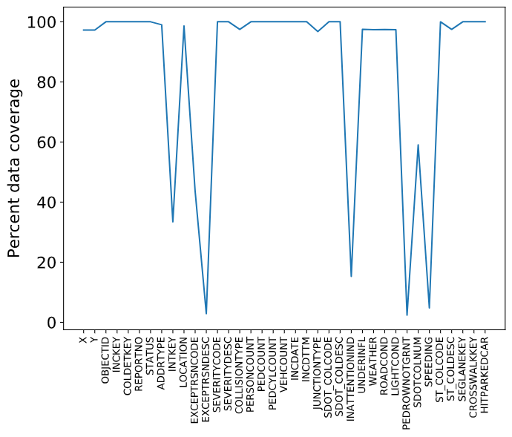
Data Processing and Engineering
Features that did not have full data coverage were either:
Filtered (Table on previous slide)
“Gapfilled” as were binary data columns and filled with opposite of rest of dataset.
Created day of year and hour of day variable from the date-time of the incident reports
At end of this; 187,504 data rows remained with 19 features.

Slide 5
Methods For Data Analysis
Initial Data Exploration:
Frequency of reports for different conditions and timing of major variables
Time of day, hour of day, weather, road, and light conditions
Determine how much, if any, differences between the two report types are in the data sets
Logistic regression – discrete dependent variable test
Attempt at classifying due to discrete nature of the dependent variable (severity code) though independent variables are not all continuous
Expectation is will not be successful
K-nearest neighbors
Likely better model given most variables in dataset are quasi-discrete even after transformation
Split into train and test set for models of 70% train and 30% test after preprocessing features to numerical values

Slide 6
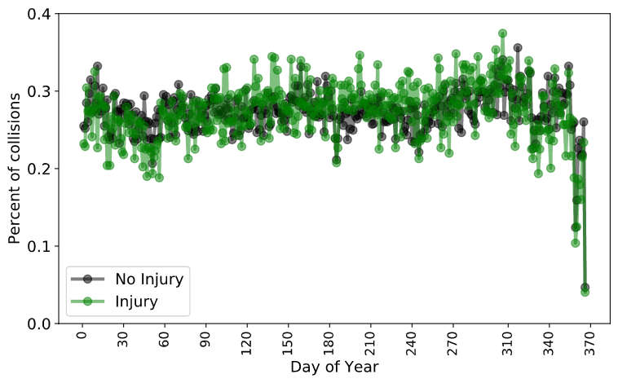
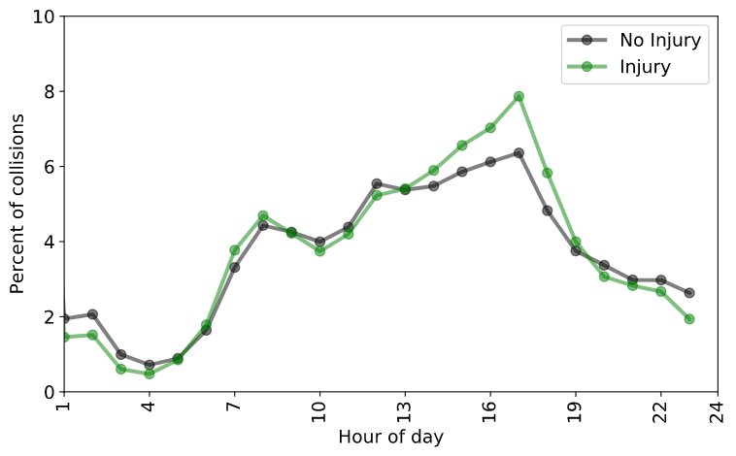
Results – Incident Timing
Time of year had minimal influence on the number of collisions:
Drop-off around the major US holidays
Minimal difference between injury and non-injury reports
More collisions occurred during the evening rush hour (16:00-18:00)
Some differences between injury and non-injury collisions but only 1-2%
Minimal chance of a collision in the early morning
Timings probably correlates to when traffic is heaviest hence increased chance of incident

Slide 7
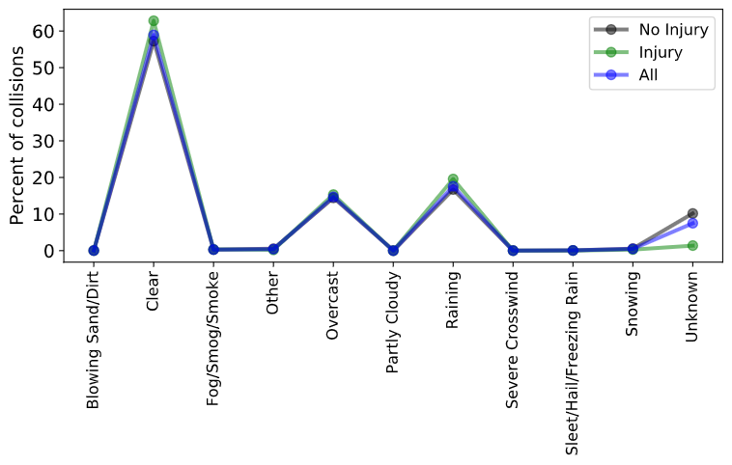
Results – Ambient Weather Conditions
Most reports occurred under clear conditions
Raining and overcast close second
As such, road conditions were either wet or dry in roughly same percentages (not shown)
Only separation of report type was for unknown weather conditions

Slide 8
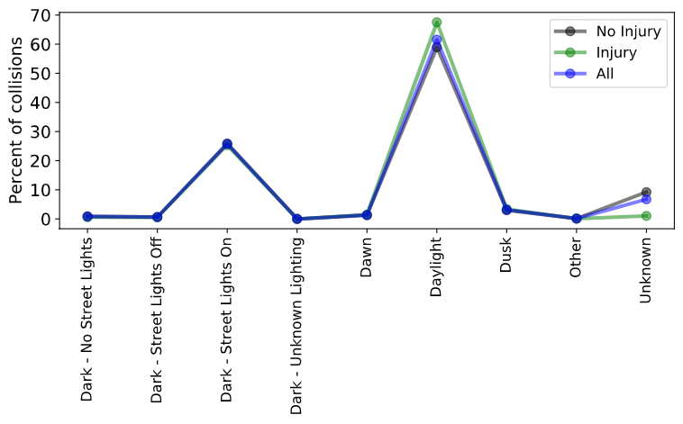
Results – Light Conditions
Most occurred during the daytime or in lighted conditions (streetlights)
Minimal separation between the report types apart from the unknown and daylight conditions.
Small differences unlikely picked up in machine learning models
Road, light, and weather conditions not major indicators of severity of collision

Slide 9
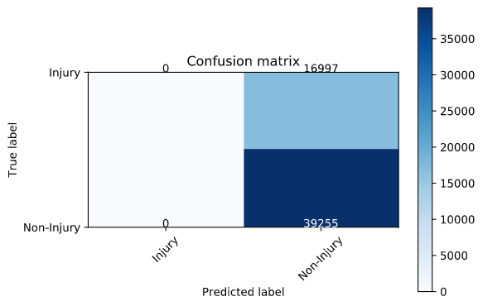
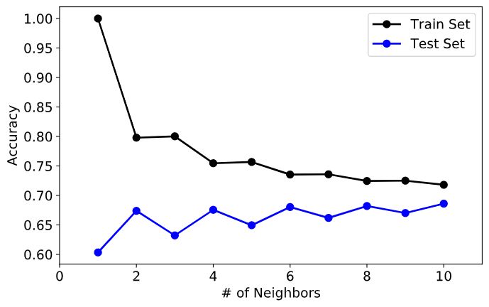
Results-Machine Learning
Two machine learning algorithms used
Logistic regression was not successful; classified everything as non-injury
KNN showed some improvement depending on number of neighbors used
Accuracy maxed out at 70%, which is the ratio of non-injury to injury reports
Suggest using 2 neighbors for any potential future modeling

Slide 10
Discussions
Minimal separation between the frequency of injury versus non-injury reports the variable means a model can’t differentiate
Need more data differentiate between the collision types
Either more features or less discrete values within the features given
Possible these two types of collisions are extremely similar yet different than more severe collisions (i.e., those with fatalities)
Initial exploratory analysis was more informative than deeper, machine learning analysis
More data required

Slide 11
Conclusions and Limitations
Conclusions:
More likely to be involved in a collision during the mid to late afternoon, which is likely when traffic is at its heaviest
Weather, road, and light conditions do play a role in collisions but in this instance not useful to determine whether there would be an injury report
Features used do not have enough information or separation to generate differences between injury and non-injury reports
Limitations:
Data does not provide information about frequency of collisions relative to total drive time
Need more severe accidents to improve model and potential usefulness
Similarities between reports limits modeling usefulness

